Slide 1
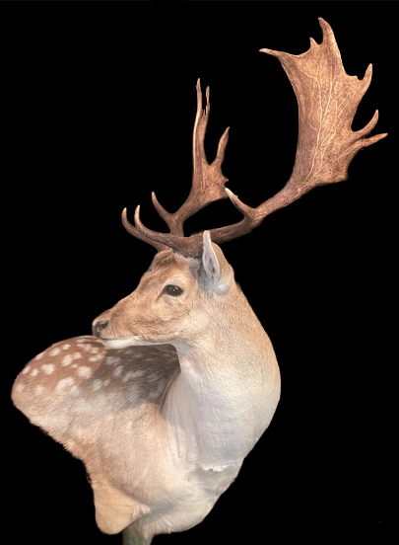
Caping for a shoulder mount
Department of Primary Industries
and Regional Development
Learn the process of caping horned or antlered game
A Hunter Learning, Education & Accreditation Program (LEAP) short course
www.dpird.nsw.gov.au/hunting

Slide 2
About this course
Department of Primary Industries
and Regional Development
1

Slide 3
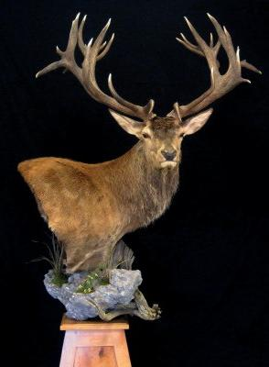
Department of Primary Industries
and Regional Development
2-3 hour, live demonstration
Learn how to properly prepare and care for your cape, ready for a taxidermist
Learn how to safely use sharp knives and tools when caping

Slide 4
Department of Primary Industries
and Regional Development
Learning outcomes
Have a basic understanding of the art of taxidermy
Know where to make the initial cuts
Be able to properly cape the face of an animal
Understand the splitting process
Be able to salt your cape correctly

Slide 5
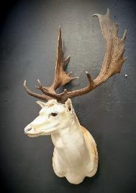
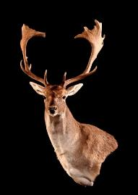
Department of Primary Industries
and Regional Development
Method
There are many methods of caping used throughout the world
The process featured in this short course is a popular and widely accepted method amongst Australian hunters and taxidermists
You may have another method that you feel more comfortable using

Slide 6
The basics
2

Slide 7
What is taxidermy?
Department of Primary Industries
and Regional Development
Derived from 2 ancient Greek words:
Taxis
(movement)
+
Derma
(skin)
= movement of skin

Slide 8
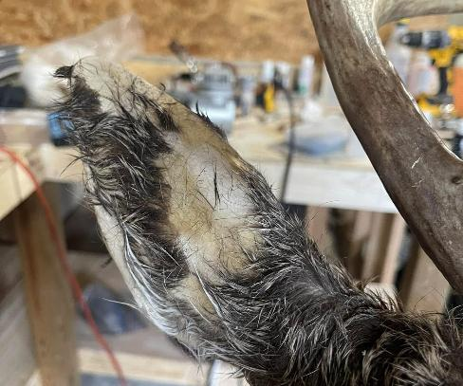
Avoid hair slip
Department of Primary Industries
and Regional Development
Most common problem taxidermists see
Caused by growth of harmful bacteria
The bacteria secrete enzymes, breaking down skin fibres
Leads to skin decay
Hair follicles become loose and easily fall out
Generally, you will need a replacement cape

Slide 9
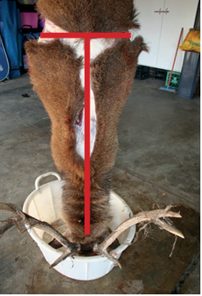
Field preparation
Begin caping as soon as possible after you harvest the animal.
Heat speeds up bacterial growth which ruin the cape.
Remove the cape and head in the field
Complete face caping at camp or home
Suspend animal off the ground or
        Lay larger animals on the ground, spreading legs apart to disperse the weight.
Avoid dragging the animal as this pulls hair from the cape

Slide 10
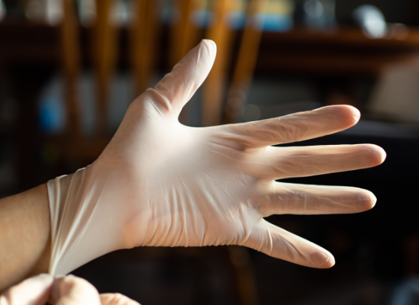
Safety considerations
Q-fever
Hydatid disease
Trichinella
Brucellosis
Ticks.
Wear disposable latex gloves and always wash your hands with a hospital grade hand cleaner if you come into contact with blood or any other body fluids.
Wild animals can carry a variety of diseases and parasites that can be harmful to humans.
Hunters should be aware of the following health concerns:

Slide 11
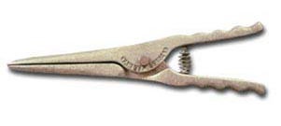


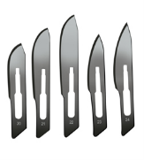
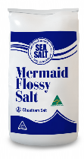
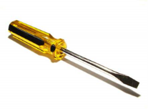

Assemble your knives and other tools
Scalpel
Skinning/ butcher’s knife
Ear pliers
Screwdriver
Steel
Spare blades
Fine natural salt

Slide 12
Initial body cuts
2

Slide 13
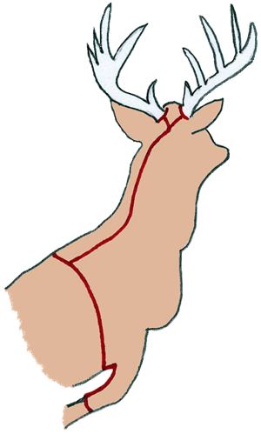
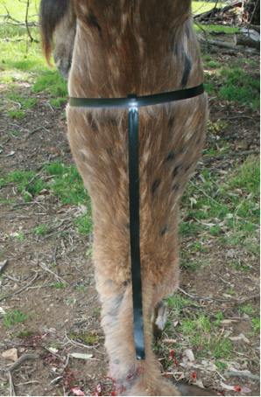
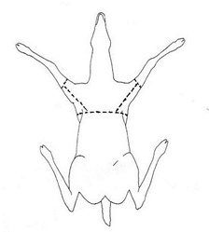
Cut 1: Abdominal cut
Department of Primary Industries
and Regional Development
    Cut around the circumference of the body, behind the rib cage

Slide 14
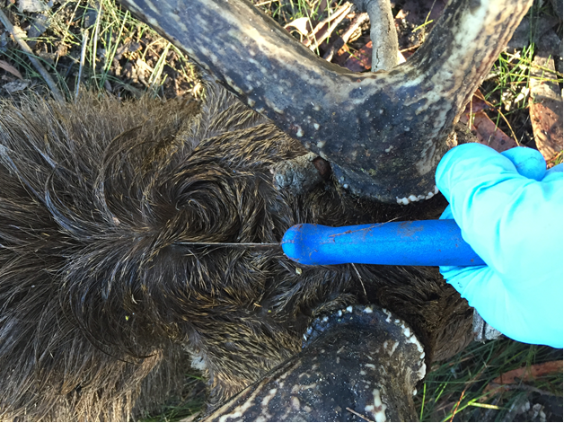
Cut 2: Y-dorsal cut
Department of Primary Industries
and Regional Development
    Make an incision 100mm from the base of the antler/horn
    Continue down the spine to meet the abdominal cut
    Return to the first cut and make a Y incision into the base of each antler/horn

Slide 15
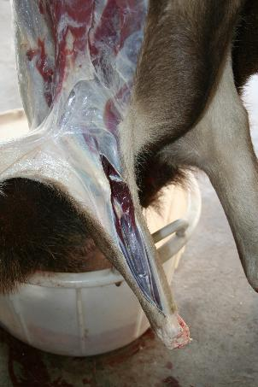
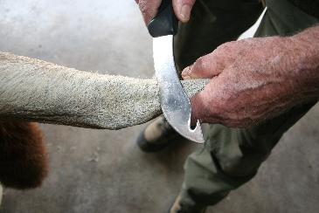
Cut 3: Leg cuts
Department of Primary Industries
and Regional Development
    Make a cut around the knee joint
    Cut up the rear of the leg along the hairline
    Continue until you reach the abdominal cut

Slide 16
Removing the skin and head
3

Slide 17
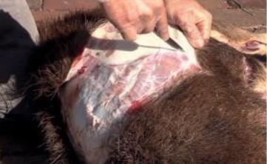
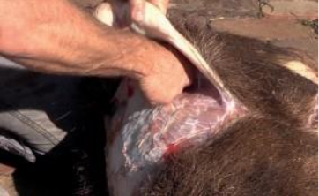
Remove the skin and head
Begin at the abdominal cut. Pull the skin away and use the knife to separate the skin from the carcass
Continue skinning towards the neck and shoulders
Begin skinning the legs from the knee cuts towards the ribcage
You can also punch the skin away using your fist instead of a knife
Remove the head by cutting through the atlas joint and under the jawbone
Complete face caping at camp or home

Slide 18
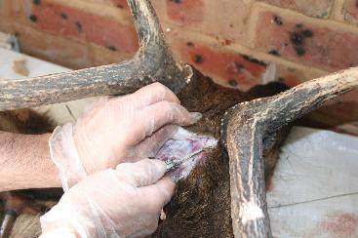
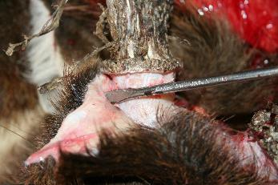
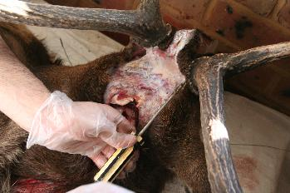
Step 1: Remove skin from antlers/ horns
Extend the cut into the pedicle and up to the coronet
Insert the flat-bladed screwdriver at a 45 degree angle into the cut
Gently tap the handle of the screwdriver, prying the skin away from the coronet
Repeat Steps 1 to 3 for the other antler or horn

Slide 19
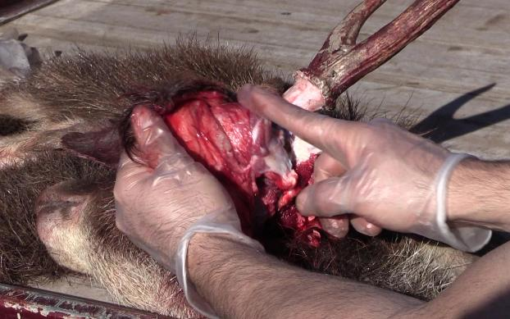
Step 2: Remove the ears
With your scalpel, begin removing the skin from the coronet back towards the ear for approximately 25mm
With your butchering knife, cut the ear away from the skull, keeping the knife blade as close the skull as possible

Slide 20
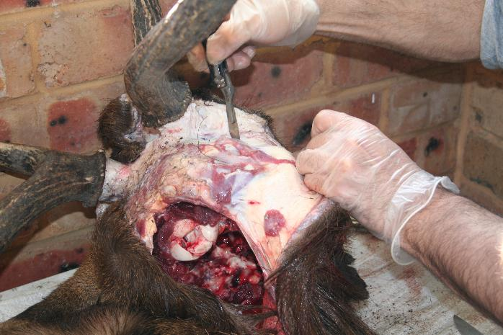
Step 3: Peel away forehead skin
Using your scalpel, take the flap of skin from the Y incision and remove it from the skull
Peel the skin forward towards the eyes, using the blade to coax the skin away from the skull

Slide 21
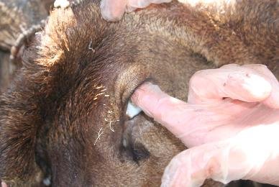
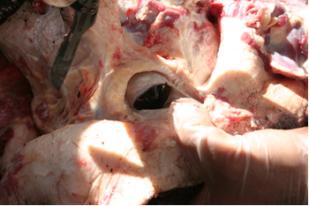
Step 4: Remove the eyelids
Take extra care with this step!
Insert your index finger into the eye socket and with your thumb, pull the forehead skin away from the skull
As you pull the skin away from the eye socket, use your scalpel to cut away the internal membrane

Slide 22
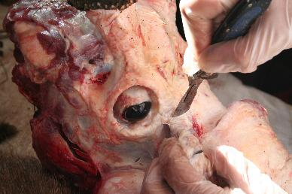
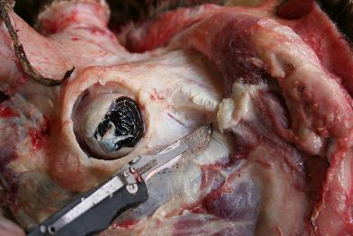
Step 5: Remove the pre-orbital gland
Using the tip of the scalpel blade, carefully extract the gland by gently coaxing the skin away from the bone
Be careful not to cut any holes in the gland
Work the scalpel blade to remove the skin from the ridge of the nose until you reach the back corner of the mouth
You can also use a flat bladed screwdriver to pry the gland out of the pocket

Slide 23
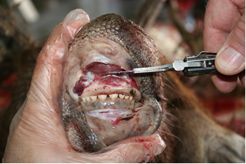
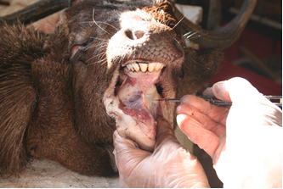
Step 6: Remove the mouth and lips
Make an incision as close to the top palate as possible then continue this cut around the gums to the rear of the mouth
Using the scalpel, cut into the skin around the gums
Repeat Steps 1 and 2 for the bottom lip, cutting along the gum line as close to the teeth as possible
Using the scalpel blade, remove the skin from under the jaw

Slide 24
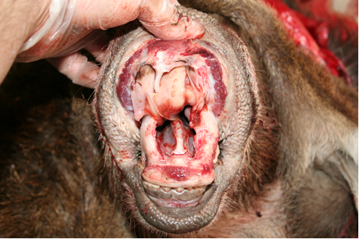
Step 7: Remove the nose
Locate the septum
Turn the top lip up towards the nose and find a vertical cartilage that is attached to the skull
Cut the cartilage with the scalpel, as close the gum line and skull as possible
Work the scalpel into the nose cavity, cutting through the septum
Septum

Slide 25
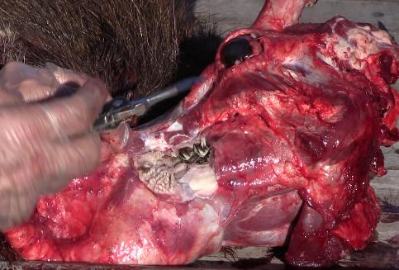
Step 8: Detaching the head skin
The head skin may still be attached to the skull near the back corners of the mouth where you will find an inner cheek with series of spikes called buccal papillae.
Pull the head skin over the face, towards the nose.
Locate the inner cheek and cut through the skin to expose the rear molars.
Using your scalpel, cut the cheek along the gum line until you reach the incisions made in the front of the mouth. Retain as much of the buccal papillae as possible
The head skin should now come away freely.

Slide 26
Splitting the lips, nose and eyes
4

Slide 27
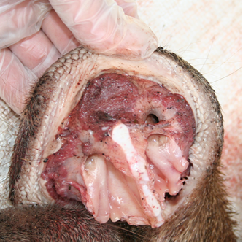
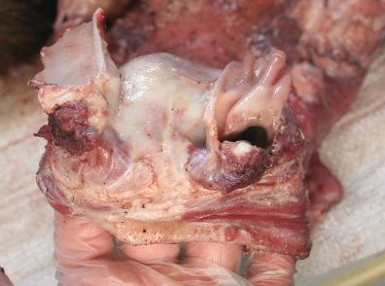
Step 1: The nose
Using your scalpel blade, cut through the centre of the septum down to the nose pad
Do not cut through the nose pad. This will split the nostrils into two tubes
Remove as much flesh and muscle tissue as possible, leaving a clean white surface
Retain at least 20mm of inner nostril

Slide 28
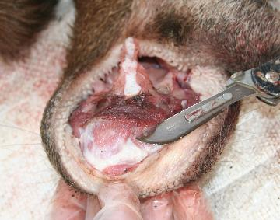
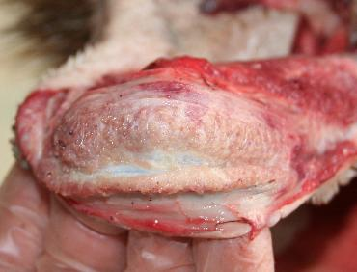
Step 2: The lips
Beginning with the top lip, locate the initial cut along the gum line below the nose.
Using the scalpel, run the blade through the flesh, between the two surfaces of the skin.
Continue to separate the two layers of skin including the lip, inner cheek and buccal papillae.
Repeat Steps 1 to 3 for the bottom lip.

Slide 29
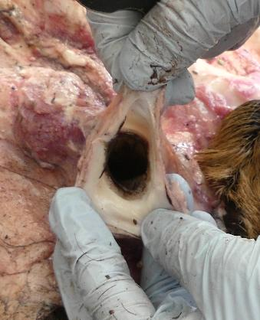
Step 3: Split the eyes
Gently swipe the blade between the cape and the tube of membrane.
Continue this process until you reach the eyelid.
(The eyelid is an off-white line at the opening of the eye.)
The membrane will be separated from the cape in the form of a transparent tube.

Slide 30
Turning the ears (splitting)
5

Slide 31
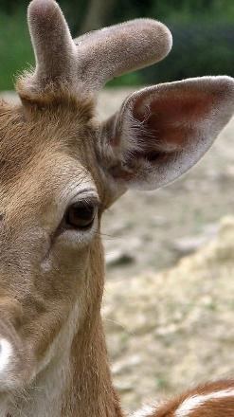
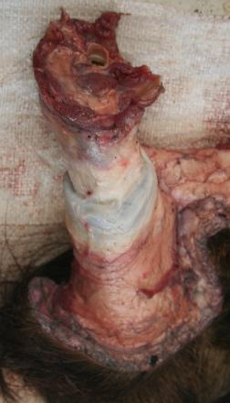
Step 1: Create a pocket
Using your scalpel, create a pocket by separating the skin from the back of the ear for about 40 to 50mm
Make sure you separate the skin from the ear butt and the apex of the ear
The apex is the V located at the front of the ear, which is the entrance to the ear canal
Apex of the ear

Slide 32
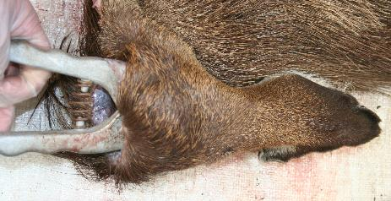
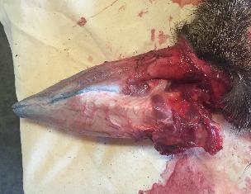
Step 2: Separate the skin
Keeping the ear pliers flat against the ear cartilage, firmly squeeze the handle to separate the skin
You may need to turn the pliers to the vertical position to free the skin
Continue squeezing the handle until you have separated the skin from the cartilage
Make sure the skin is separated all the way to the tip and the outer edge of the ear
You may need to use the scalpel to separate the ear edges

Slide 33
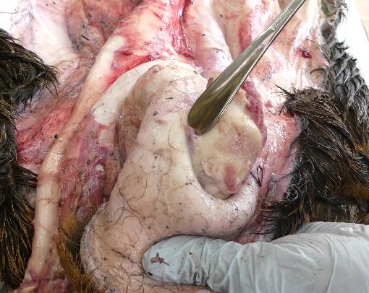
Step 2 – Alternative method
If you do not have ear pliers, insert a flat tool into the pocket you just created.
Work the tool into the ear to separate the skin.
Continue this process until you have separated the skin all the way to the ears outer edge.

Slide 34
Salting the cape
6

Slide 35
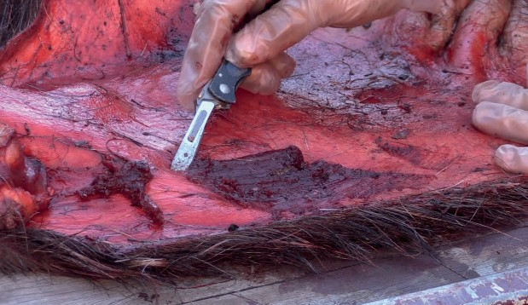
Step 1: Remove excess fat, muscle or tissue
Using a filleting or skinning knife, pull away any muscle tissue from the skin, allowing the blade to remove the excess flesh.
Dice stubborn muscle tissue with a very sharp knife by cutting straight lines through the meat at 1cm intervals.
Repeat the cuts at a 90 degree angle. Be careful not to cut through the skin.

Slide 36
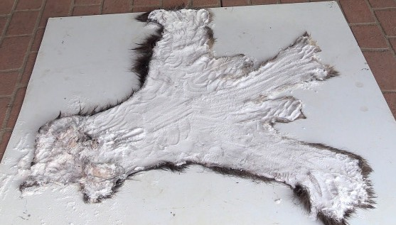
Step 2: Salt the cape
Lay the cape flat on a bench.
Cover the entire cape with a generous layer of salt, rubbing the salt into the split areas of the eyes, ears, nose and lips.
You may need to unroll the lips so they lie flat.
If you cannot salt the cape, it must be sealed in an airtight bag or container and frozen.

Slide 37
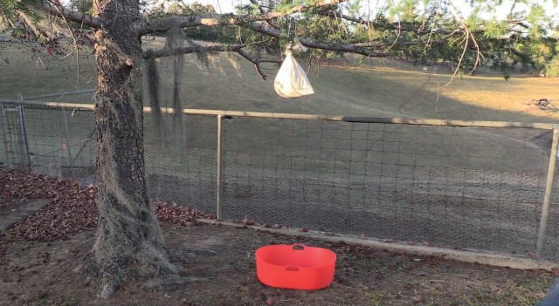
Step 3: Roll and hang the cape
Once the skin is completely salted, turn
the face inside out so the flesh side
remains inside the cape
Take the skin from the brisket and fold it
into the shoulder area
From the nose, tightly roll the cape as you would a sleeping bag
Place the cape in an old pillowcase or a
hessian bag
Hang the bag with the cape in cool place
out of the sun and allow it to drain
Place a bucket under the bag to
catch the fluid

Slide 38
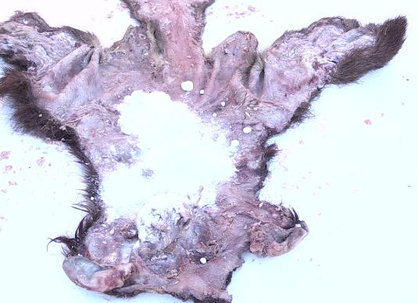
Step 4: Resalt the cape
After 24 hours, unroll the cape
Scrape the original salt from the cape and discard it
Re-salt the entire cape and lay it flat for another 24 hours
If the cape has not adequately dried after the second salting, repeat the process after another 24 hours.
When adequately dried, shake off the excess salt and roll the cape.
The cape is now ready to send to the taxidermist.

Slide 39
Congratulations!
You’ve completed the Caping for a shoulder mount short course
Questions?

